Slide 1


Risk Measurement vocabulary
Notes:
We have been exposed to many ERM terms so far, but lets continue to build our ERM vocabulary by reviewing key measurement terminology and their meaning.

Slide 2
IST 425: The Enterprise Risk Management (ERM) Process
Organizational
Assessment & Risk Culture
Risk Infrastructure/ Governance
Risk Identification
Risk Measurement
and Indicators
Risk Management
Monitoring: Each part of the process can influence every other
Contingency Planning
& Disaster Recovery Planning
Notes:
We are now at the Measurement step in ERM, that of assessing and prioritizing the risks we identified. This also includes identifying or developing relevant indicators. Let’s define some of the terms used.

Slide 3
Agenda - Glossary
Probability/Likelihood
Frequency
Loss/Impact
Speed of Onset/Velocity
Vulnerability
Velocity/Speed of Onset
Volatility
Traditional Risk Formula
Inherent Risk
Risk Model
Risk Registry and Reports
Total Risk and Risk Exposure
Risk Management Activity
Notes:
This lecture focuses mostly on definitions of a few key terms. There are many others. Use external resources to clarify your understanding.

Slide 4
Probability/Likelihood
Probability
Related to percentage chance that an event will happen
Statistical measure
If something is certain to occur, it has a probability of 1
Needs parameters
E.g. within next week, next month, 100 years)
Likelihood
Also related to chance that an event will happen
Best estimate measures; not exact
Often qualitative or backed by estimates (Low, Moderate, High chance)
Can be a surrogate for statistical estimates
Various methods and data needed to increase accuracy
Notes:
Probability and likelihood are often used interchangeable. For others, probability refers to statistical measure and likelihood is a surrogate for estimates.

Slide 5
Example: Sample Probability vs Likelihood Categories
Category | Probability of Event | Likelihood or Chance of Occurrence
Expected/routine Unexpected Rare Extremely Rare | 100 % 10 % 1.0 % 0.1 % | At least annually 1 in 10 years 1 in 100 years 1 in 1000 years
Notes:
Here is an example of a scale of probability or likelihood that considers both the statistical probability and general prediction of likelihood. Even where statistical analysis is done, it is frequently based on somewhat inexact measures. The more historical data we have, the better, however, there can be a certain randomness in history. For example, the so called 1000 year floods in Colorado and the record breaking snow storms in the Boston area that exceeded even modern building codes for roof strength.

Slide 6
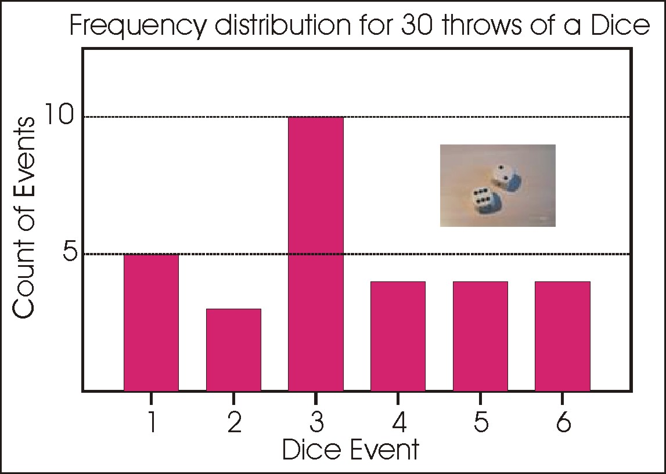
Frequency
How often a risk event occurs
Can be expressed in cumulative frequency plots
Permits a comparison based on different levels of expected risk
Clumps or ignores contributing factors or issues
Notes:
Let’s look at some specific measures of risk. One of the measurement dilemmas is determining the likelihood that a risk will occur or determining the frequency of possible risk events. For example, we have been talking about probability or likelihood of loss. Both can be expressed in cumulative frequency plots. The importance is that they can be used to allow comparison based on different levels of expected risk.

Slide 7
Loss/Impact
Extent to which an event will affect organization
May consider multiple impacts
Financial (real costs, impact on share price, lawsuits, etc.)
Security
Reputation
Physical Assets
Humans – Customers, Employees, or other impacts
Measurement metrics depend on issue
E.g. Loss of lives, loss of access, money, share price
Often reduced or translated to monetary value
Notes:
Loss or impact refer to the extend that an event will affect an enterprise. The metrics used to calculate this may vary and may even include multiple considerations rather than a single one. For example, a data breach incur real financial losses in recovery costs or impact on share price, as well as reputational loss.

Slide 8
Vulnerability
Susceptibility to a risk event
Vulnerability may change at different times or under different circumstances
Examples
Succession of a new CEO
Loss of key person
Scandal or lawsuit
Merger or Acquisition
Unusual volatility in market
Competitor actions
Notes:
How susceptible are we to a risk. Very large companies may not be as concerned about storm damage but a smaller enterprise could be crippled. A loss of our warehouse facility may be more critical before a peak retail period, than during a slow season.

Slide 9
Velocity / Speed of Onset
Length of time between occurrence of risk event and point at which it affects company
Examples
Proposed legislation to be voted on
Deadlines for compliance to new legislation
CEO or Board member decides to retire
Lawsuit filed with high potential penalties
Notes:
What is the length of time between the occurrence of a risk event and when it impacts the enterprise. As an example, the Sarbanes Oxley legislation allowed companies many years before they had to prove compliance. Other legislation has been retroactive and required immediate responses.

Slide 10
Volatility
Rate of change in probability/likelihood
The volatility of a risk may vary based on contributing factors or root causes
E.g. Likelihood of loss/gain in stock portfolio changes due to market uncertainty before or after elections, war or legislative uncertainty
Notes:
Some risks are more volatile than others and may require metrics that assess their value over a range of intervals. For example, Value-at-Risk (VAR) calculations may consider values from varying periods to assess the range of our risk exposure.

Slide 11
Traditional Risk Formula
Risk = Probability X Loss or R = P x L
Example:
Annual probability of event equals .05
Inherent risk calculated at $1,000,000 each year
Risk = (P) .05 x (L) $1,000,000
Risk = $ 50,000
If insurance costs $10,000 a year, would you feel this was a justified expense to transfer the loss
If this inherent risk could be mitigated to reduce the probability to .01 annually, then how much would you be willing to spend to mitigate and transfer/insure?
Notes:
The traditional risk formula is Risk equals probability time loss. Based on the above figures, would you insure this risk? Would you invest in mitigation efforts to reduce the probability of the loss happening? Which would you do first?

Slide 12
Inherent Risk
The risk exposure of an event prior to consideration of any controls or mitigation efforts
Typically assessed along multiple attributes, e.g.
Probability/Likelihood
Impact
Vulnerability
Speed of Onset
Velocity
Notes:
Calculations for inherent risk can be much more complicated.

Slide 13
Example: Probability of Delay in Project
E.G.: Risk Value of a Delay due to “Attitude of Local Government toward Pipeline Construction”
What is the probability that local government will delay approval of security protocol or new pipeline construction? (ProbDelay)
What is likely length of time of any delay in months (vulnerability)? (LengthDMth)
What is cost per unit time (loss) of delay? (CostD)
= (ProbDelay) x (LengthDMth) x (CostD)
Notes:
Note that there is an additional factor in this risk calculation – the likely length of the delay. This is a reflection of the vulnerability that is part of the probability calculation. Therefor, this calculation includes TWO probability calculations.

Slide 14
What is a Risk Model?
Webster’s dictionary provides two relevant descriptions of a model
A description or analogy used to help visualize something that can be directly observed
A system of postulates, data, and inferences presented as a mathematical description of an entity or state of affairs
A Risk Model is therefore either
A verbal description, or
A mathematical description that helps us “visualize risk”
Benefits of risk models
Forces participants to agree on what the question is to be answered
Enables visual representation of complex data and relationships
Notes:
There are two relevant descriptions of a model. Either a “A description or analogy used to help visualize something that can be directly observed” or “A system of postulates, data, and inferences presented as a mathematical description of an entity or state of affairs.” Risk models can be either qualitative or quantitative. Modeling also requires clear definitions and descriptions.

Slide 15
Risk Registry and Reports
Records the following
Description/definition of risk or risk event
Assessment and rating of probability (or likelihood)
Assessment and rating of severity (or impact)
Assessment and rating of control effectiveness
Responsible person (risk owner) and oversight committees
Management response and action plans
Notes:
Risk registries include information about various enterprise risks, including the definition and various metrics. It also include the risk owner or who is held accountable for monitoring and managing that risk and any higher level oversight committees. Don’t confuse this with a silo approach. Even risks that could impact the enterprise will likely have a first line manager who is responsible.

Slide 16
Risk Management Activity
May be used to help prioritize risks once initial assessment completed
Considers what is already being done to manage a risk
Often linked to risk ranking, e.g. from no risk to critical
1 | 2 | 3 | 4 | 5
Activity NOT commenced | Activity commenced but in outline only | Activity partially completed | Activity almost completed | Activity completed satisfactory
Critical Risk | Major Risk | Significant Risk | Minor Risk | No Risk to Project
Notes:
This sample risk activity scale can be used to assess what is currently being done to mitigate, transfer or otherwise treat this risk. This type of scale can also be used to help prioritize or categorize risks that may have a similar probability and impact. In project management, scales like this may be used to assess assigned activities, but using a single metric of whether the task has been started. Realistically, this should be related to the due date or the prioritization of the risk.

Slide 17
Risk Exposure, Total Risk, and Residual Risk
The goal of managing risk is to reduce our “exposure” to risk
Total Risk Exposure or Total Inherent Risk or Total Unmitigated Risk
Either from the whole portfolio or class of risks
OR in regard to a single risk
E.g. Value at Risk (VAR ) BEFORE mitigation, transfer, or sharing strategies
Residual Risk
What is left over AFTER management efforts (e.g. mitigation, transfer, sharing, etc.)
Where we need contingency plans and incident response/disaster recovery
Notes:
We have talked about inherent risk. Total risk may be used to refer to inherent risk in a single risk, or the total risk across a portfolio of risks. Residual risk is the risk that remains after all our efforts to reduce it, share it, or transfer it. Total risk or unmitigated risk exposure is basically the Value at Risk BEFORE any additional mitigation, transfer or sharing strategies are put into place. This is the risk that we need to develop contingency plans for.

Slide 18
Summary
ERM measurement foundational vocabulary
Your organization may use different terminology
Not all ERM terminology is standardized
Take advantage of the many resources available to you to increase your ERM vocabulary
Books
Associations (RIMS)
Proprietary and open databases
Notes:
Although there are standardized terms, your organization may have different terminology relevant to their industry. Continue building your ERM vocabulary.

